Slide 1
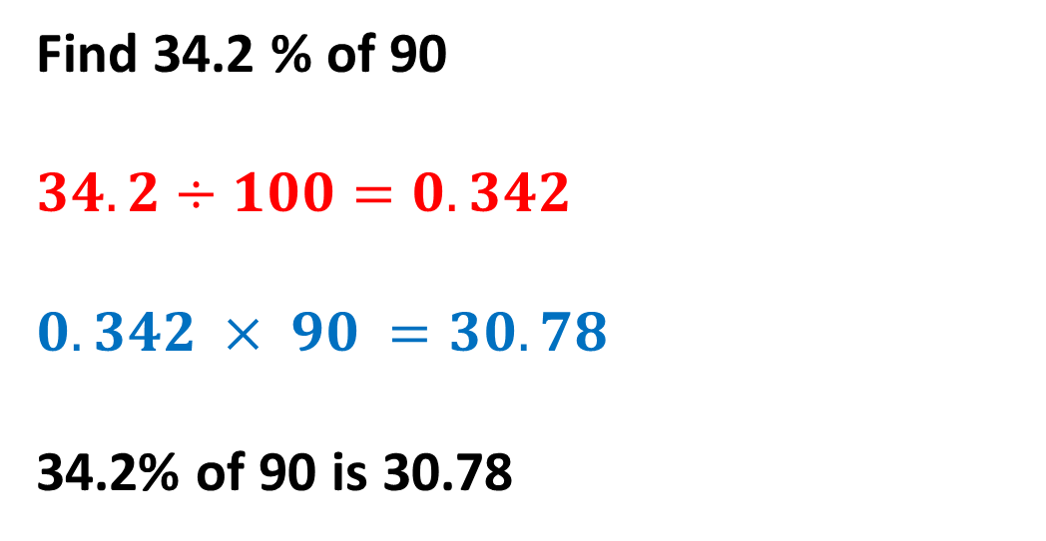
Daily Review
Finding a percentage using decimal multiplication:
Convert the percentage to a decimal by dividing by 100. Multiply the amount by the decimal.
Find 34.2 % of 90
$$34.2÷100=0.342$$
$$0.342 × 90 =30.78$$
34.2% of 90 is 30.78
CFU 1
What is the 1st step? The 1st step is to ……..
CFU 2
What is the 2nd step? The 2nd step is to ………

Slide 2
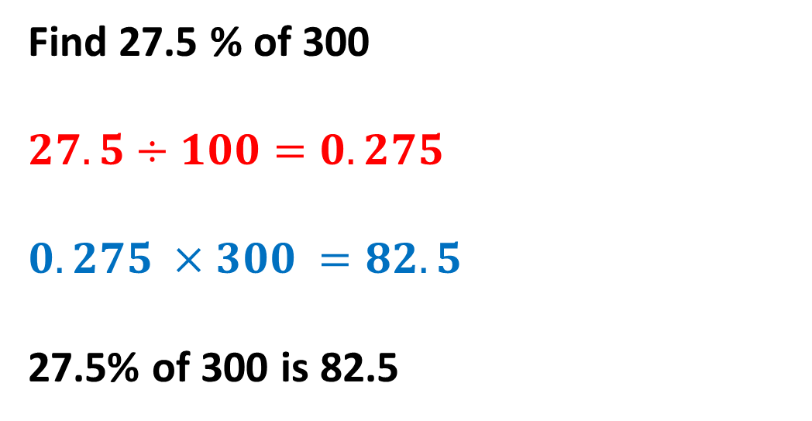
Daily Review
Finding a percentage using decimal multiplication:
Convert the percentage to a decimal by dividing by 100. Multiply the amount by the decimal.
Find 27.5 % of 300
$$27.5÷100=0.275$$
$$0.275 ×300 =82.5$$
27.5% of 300 is 82.5
CFU 1
What is the 1st step? The 1st step is to ……..
CFU 2
What is the 2nd step? The 2nd step is to ………

Slide 3
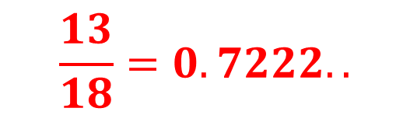
Daily Review
Write an amount as a percentage of another:
Write the amount as a fraction of a total. 2. Multiply by 100 to get the percentage.
Tyler scored 13 out of 18 on his French test.
What percentage did he get?
CFU 1
What is the 1st step? The 1st step is to ……..
$$\frac{13}{18}=0.7222..$$
CFU 2
What is the 2nd step? The 2nd step is to ………
$$0.7222 ×100=72.2\% (1 d.p.)$$
Tyler scored 72.2% on his French test.
We could simplify this to $\frac{13}{18}×100=72.2\%.$

Slide 4
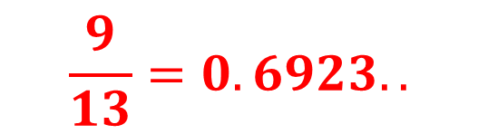
Daily Review
Write an amount as a percentage of another:
Write the amount as a fraction of a total. 2. Multiply by 100 to get the percentage.
Ashe kicked nine goals from 13 shots at goal.
Calculate Ashe’s percentage kicking accuracy.
CFU 1
What is the 1st step? The 1st step is to ……..
$$\frac{9}{13}=0.6923..$$
CFU 2
What is the 2nd step? The 2nd step is to ………
$$0.6923 ×100=69.2\% (1 d.p.)$$
Ashe’s kicking accuracy is 69.2%.
We could simplify this to $\frac{9}{13}×100=69.2\%.$

Slide 5
Y11 Apps Chapter 2 Situation 1
The workforce at a factory were all told ‘Due to lost contracts, you will now only work a 4 day week. You will receive a reduced salary of your original salary decreased by 20%.’
Shortly afterwards, things improved and the workforce were told ‘We can return to our 5 day week. You will now receive the salary you have been receiving recently increased by 20%.’
Does this mean that salaries have returned to their original rates?
Imagine a worker on $50 000 a year originally.
A 20% decrease meant they were receiving 80% of their original salary.
0.80 x 50 000 = 40 000
So their salary was reduced to $40 000 a year.
Now salaries increase by 20% again.
A 20% increase means they are receiving 120% of their reduced salary.
1.20 x 40 000 = 48 000
So their salary has increased to $48 000, less than what they originally earned.

Slide 6
Y11 Apps Chapter 2 Situation 2
A newspaper article talking about a new drug for a medical condition states that it has ‘the potential to increase the likelihood of a person taking the drug from developing a particular form of diseaes by up to 50% of the risk for someone not taking the drug.’
The article also states that ‘for people not taking the drug there is a 1% chance of developing this disease.’
Mr Chan is taking this drug and is very concerned to read that the risk of developing this type of disease is 51%!
Is this correct?
The risk of developing the disease is 1% if you are not taking the medication.
The increased risk if you are taking the medication is up to 50% more THAN the 1% risk if you aren’t.
50% of 1% is 0.5% so the actual risk if you take the medication is only up to 1.5%, not as bad!

Slide 7
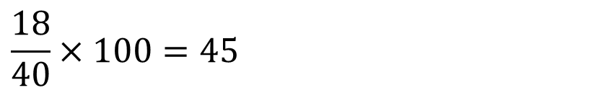
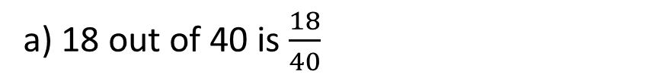
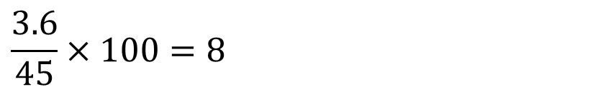
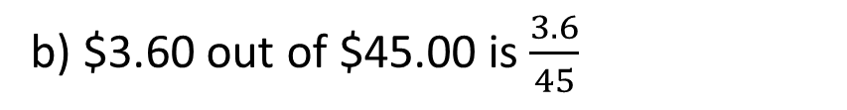
Y11 Apps Chapter 2 Example 1
Express each of the following as a percentage.
18 students out of a total of 40 students
$3.60 out of $45.00
$34 out of a total of $245 (to 1 decimal place)
Step 1: Express it as a fraction.
Step 2: Find this fraction of 100.
a) 18 out of 40 is $\frac{18}{40}$
b) $3.60 out of $45.00 is $\frac{3.6}{45}$
You do c)
$$\frac{18}{40}×100=45$$
$$\frac{3.6}{45}×100=8$$
$34 out of $245 is 13.9%.
18 students out of 40 is 45%.
$3.60 out of $45.00 is 8%.

Slide 8
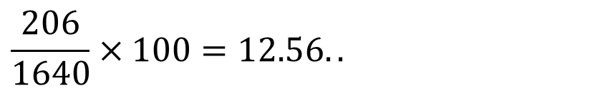

Y11 Apps Chapter 2 Example 2
The price of a commodity increases from $1640 per tonne to $1846 per tonne. Express the increase as a percentage increase, correct to 1 decimal place.
Step 1: Find the value of the increase or decrease.
Step 2: Express it as a fraction.
Step 3: Find this fraction of 100.
Increase = $1846 - $1640
= $206
$206 out of $1640 is $\frac{206}{1640}$
$$\frac{206}{1640}×100=12.56..$$
The price of the commodity has increased by 12.6%.

Slide 9
Y11 Apps Chapter 2 Example 3
Find 27% of $60, with and without a calculator.
With a calculator:
Step 1: Find the decimal equivalent of the %.
Step 2: Multiply the amount by the decimal.
Without a calculator:
Step 1: Find 1% of the amount.
Step 2: Multiply this by the % you want.
27% is equivalent to 0.27 (27/100 = 0.27)
1% of $60 = 60/100 = 0.6
0.27 x 60 = 16.2
27% of $60 = 0.6 x 27
27% of $60 is $16.20
27% of $60 is $16.20

Slide 10
Y11 Apps Chapter 2 Example 4
Increase $450 by 24%, with and without a calculator
With a calculator:
Step 1: Add or subtract the percentage increase or decrease from 100%
Step 2: Find the decimal equivalent of the %.
Step 3: Multiply the amount by the decimal.
Without a calculator:
Step 1: Add or subtract the percentage increase or decrease from 100%.
Step 2: Find 1% of the amount.
Step 3: Multiply this by the % you want.
100% + 24% = 124%
100% + 24% = 124%
1% of $450 = 450/100 = 4.5
124% is 1.24 as a decimal
124% of $450 = 4.5 x 124
1.24 x 450 = 558
$450 increased by 24% is $558
$450 increased by 24% is $558

Slide 11
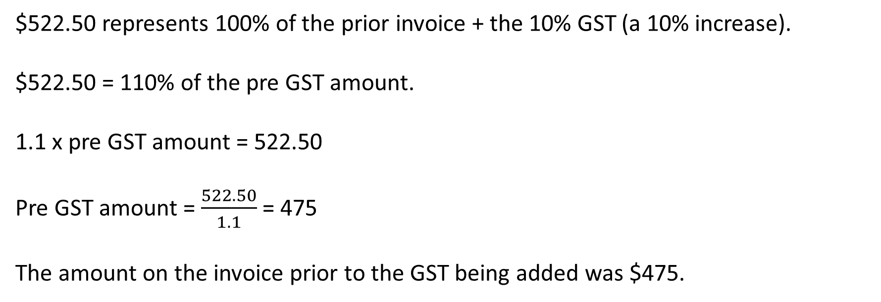
Y11 Apps Chapter 2 Example 5
Now do Exercise 2A
After the 10% goods and services tax (GST) has been added to an invoice, the final amount payable is $522.50.
Determine the amount on the invoice prior to the GST being added.
$522.50 represents 100% of the prior invoice + the 10% GST (a 10% increase).
$522.50 = 110% of the pre GST amount.
1.1 x pre GST amount = 522.50
Pre GST amount = $\frac{522.50}{1.1}$= 475
The amount on the invoice prior to the GST being added was $475.

Slide 12
Y11 Apps Chapter 2 Situation 3
Now do Exercise 2B
Inflation is the rise in the price of goods over a period of time. Inflation is usually quoted as an annual percentage rate based on the increase in the price of goods and services typically used by a household.
Each dollar has less purchasing power than a dollar earned the previous year. For example, the amount of fruit and vegetables that could be purchased for $1 in 1950 would be significantly higher than in 2021. The $1 has lost purchasing power.
If a loaf of bread costs $1.20 and the annual inflation rate is 2.6%, the same loaf of bread would cost $1.23 the following year. (1.20 x 1.026 = 1.2312)
If the annual inflation rate then jumped to 7.8%, the loaf of bread would cost $1.33 the year after. (1.2312 x 1.078 = 1.3272…)
The opposite of inflation is deflation (where prices go down over time) although this is not common.

Slide 13
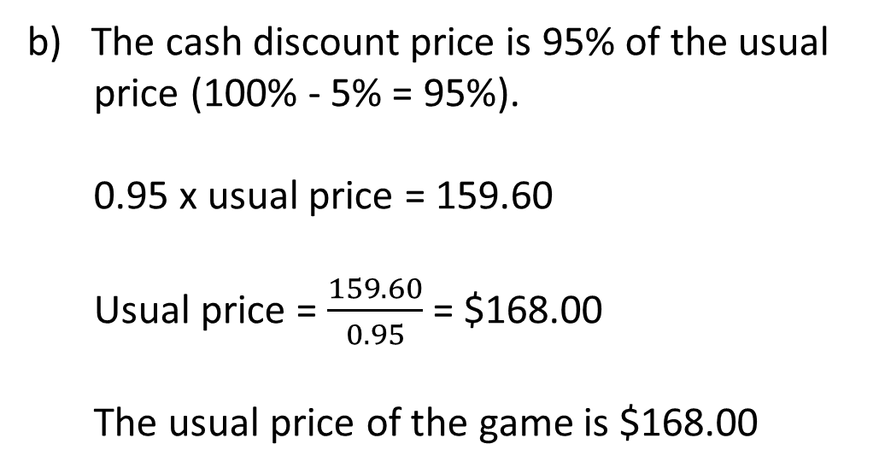
Y11 Apps Chapter 2 Example 6
A shop offers 5% discount on all good purchased with cash rather than credit cards.
What is the cash discount price for a jacket that usually costs $85.00?
If a computer game has a discounted price of $159.60 for cash, what is the usual price of the game?
The cash discount price is 95% of the usual price (100% - 5% = 95%).
0.95 x 85 = 80.75
The discounted price of the jacket is $80.75.
The cash discount price is 95% of the usual
price (100% - 5% = 95%).
0.95 x usual price = 159.60
Usual price = $\frac{159.60}{0.95}$= $168.00
The usual price of the game is $168.00

Slide 14
Y11 Apps Chapter 2 Situation 4
The fees charged by a business for selling an item (like a house) is sometimes based on the price the item sells for.
The amount of pay some people receive is sometimes based on the quantity or value of sales they make.
Both of these are examples of commission (and are often a percentage of the value).
If a computer sales person is paid 15% commission on their sales, and they sell $17 650 worth of goods one month, their commission would be $2647.50 (17 650 x 0.15).
If a real estate agency charges commission on the sale of a house as follows:
3% of the first $100 000
2.5% of the next $150 000
2% of the next $150 000
Then a house sold for $365 000 would earn commission of $9050.
0.03 x 100 000 = 3000
0.025 x 150 000 = 3750
0.02 x 115 000 = 2300
9050

Slide 15
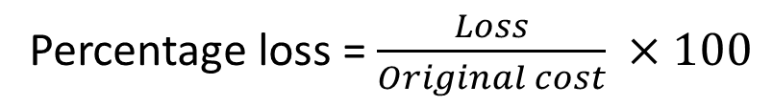
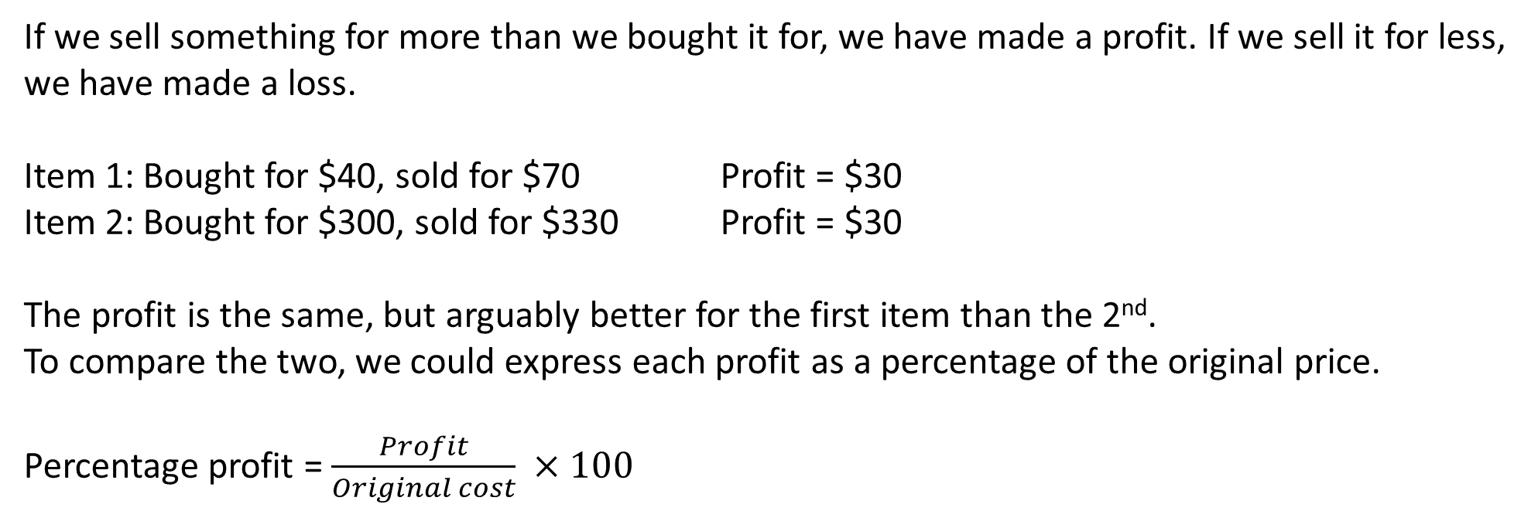
Y11 Apps Chapter 2 Situation 5
Now do Exercise 2C
If we sell something for more than we bought it for, we have made a profit. If we sell it for less, we have made a loss.
Item 1: Bought for $40, sold for $70 Profit = $30
Item 2: Bought for $300, sold for $330 Profit = $30
The profit is the same, but arguably better for the first item than the 2nd.
To compare the two, we could express each profit as a percentage of the original price.
Percentage profit = $\frac{Profit}{Original cost} ×100$
Percentage loss = $\frac{Loss}{Original cost} ×100$
Item 1: $\frac{30}{40}×100=75\%$ percentage profit
Item 2: $\frac{30}{300}×100=10\%$ percentage profit

